Slide 5
Bilateral organizations lead by CERBA

Slide 6
Events of importance organized by CERBA
Mining Conference (Toronto)
Construction conference (Toronto)
Aerospace mission to Ukraine
Aerospace mission to Russia
Québec mission to Russia
Mining mission to Uzbekistan
Launch of the Manitoba chapter of CERBA

Slide 7
Some CERBA members

Slide 8
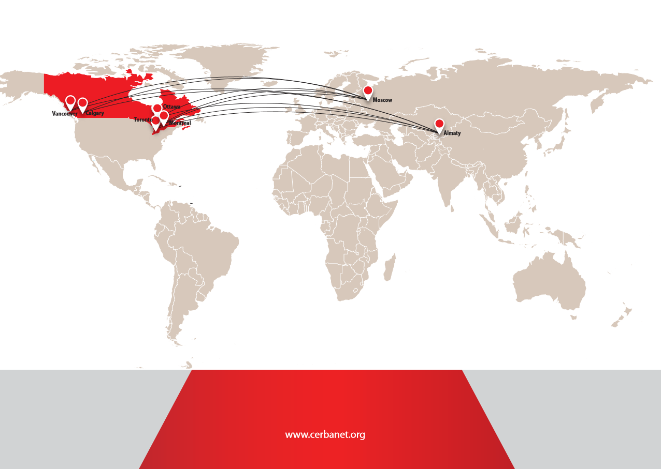
Thank you!

