Slide 1

KEY STEPS IN A LOCATION CHOICE
September 29, 2017

Slide 2
CAI Global Group Overview

Slide 3
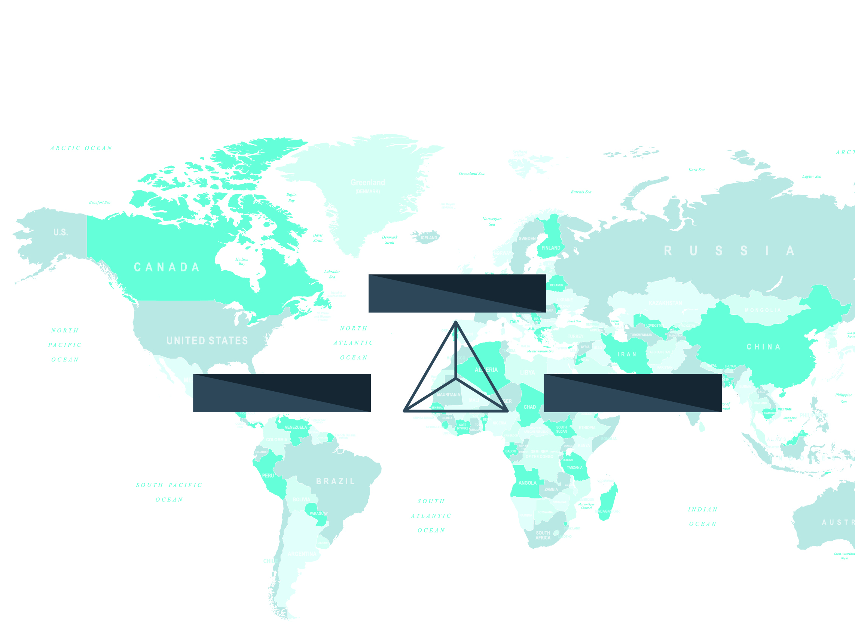
WHO WE ARE
THE CAI GLOBAL GROUP
is a location advisory firm with over 30 years of experience in investment project strategy, financing and site selection
CAI
COMPANY
GOVERNMENT
3
Notes:
Enlève le triangle a gauche, mettre qqchose une texture

Slide 4
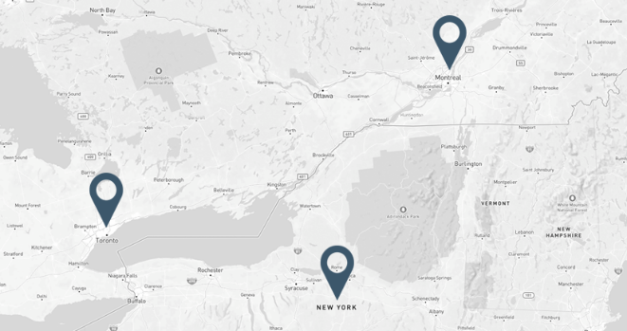
GENERAL FACTS
$9.5 billion in capital investment projects
27,000 jobs created and retained in the private sector
125 economic development agencies and jurisdictions in North America
Montréal
Toronto
New York
4

Slide 5

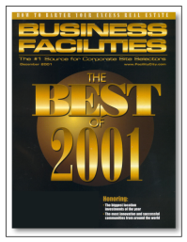
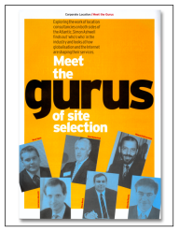


ACHIEVEMENTS
CAI has been recognized by London, England’s Corporate Location Magazine
as one of the top six SITE SELECTION GURUS WORLDWIDE
CAI was awarded the GOLD PRIZE in the Private Developers Category of
BUSINESS FACILITIES MAGAZINE’S NINTH ANNUAL ECONOMIC DEVELOPMENT ACHIEVEMENT AWARD
CAI HAS BEEN ON THE JUDGE’S PANEL FOR
BUSINESS FACILITIES MAGAZINE’S BUSINESS DEAL OF THE YEAR AWARD FOR OVER 15 YEARS
5

Slide 6


CORPORATE SERVICE OFFERINGS
REINVESTMENT IN EXISTING FACILITY
ACQUISITION
NEW FACILITY IMPLEMENTATION
Development of government relations strategy
Development of business case for use with different government agencies
Identification of external support programs
Intermediary between government and the company
Maximizing and securing incentives
Advisory services in contract negotiations
Claims facilitation
Acquisition targeting
Corporate strategy validation
Business environment evaluation
Confidential representation
Assessment of different investment options
Identification of potential buildings or sites
Site benchmarking analysis
Decisional support to determine optimal sites
Negotiating, securing and maximizing incentives
Due diligence and negotiation assistance in real estate transaction
Assistance with different permits, identification of service providers, etc.
INVESTMENT PROJECT
6

Slide 7
SAMPLE OF
CAI’S CLIENT BASE

Slide 8












Sample of our clients

Slide 9












Sample of our clients

Slide 10
The investment criteria

Slide 11
SITE AND LOCATION BENCHMARKING
FACTORS AFFECTING A LOCATION DECISION
25 TO 40
BUSINESS ENVIRONMENT
SITE AND BUILDING
WORKFORCE
INVESTMENT CRITERIA ARE GENERALY EVALUATED IN THE DECISIONAL MATRIX FOR INVESTMENT PROJECTS
Source: The CAI Global Group Inc., 2017
11

Slide 12
SITE SELECTION FACTORS
Site Selection Factors | Ranking
1. HIGHWAY ACCESSIBILITY | 94.4%
2. AVAILABILITY OF SKILLED LABOR | 89.8%
3. LABOR COSTS | 89.6%
4. OCCUPANCY OR CONSTRUCTION COSTS | 86%
5. STATE AND LOCAL INCENTIVES | 84%
6. CORPORATE TAX RATE | 82.3%
7. TAX EXEMPTIONS | 79.7%
8. ENERGY AVAILABILITY AND COSTS | 78.5%
9. PROXIMITY TO MAJOR MARKETS | 78.1%
10. QUALITY OF LIFE | 76.4%
Source: Area Development, Corporate Survey, 2016

Slide 13
The Site Selection Process

Slide 14
SITE SELECTION
A process that is part of a company's strategy but does not happen frequently
The decision affects the overall competitiveness of the company:
  Operations
  Business development
  Human resources
It affects not only the company's costs, but also its revenues
80%
OF THE OPERATIONAL EXPENSES ARE FIXED BY THE LOCATION OF YOUR OPERATING FACILITY
Notes:
Marc

Slide 15
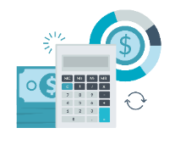


THE INVESTMENT PROJECT MATRIX
Implementation
Financing
Site Selection
Strategy
Source: The CAI Global Group Inc., 2017

Slide 16
THE SITE SELECTION PROCESS
PRELIMINARY RESEARCH
COMMUNITY APPROACH
BENCHMARK LOCATIONS
& SITES
DUE DILIGENCE REVIEW
LOCATION CHOICE
  Validation of strategic objectives
  Identification of target region(s)
  Identification of investment criteria and weight
  Development of regional profiles
  Preliminary evaluation of options
  Send Request for Information (RFI)
  Real estate search
  Identification of incentives
  Collection of information and data to benchmark locations
  Selection of sites to be analyzed in the decisional matrix
  Valuation of incentive package offers
  Site visits
  Recommendation of sites to pursue
  Revisit short-listed sites
  Update project budget
  Negotiate and secure incentives and real estate agreements
  Select a site to move forward with
  Receive input from executive team and/or the Board of Directors
  Development of communication strategy
  Coordination of press conference
  Preparation for implementation and start-up of operations
  Signing of incentive and lease agreements
Source: The CAI Global Group Inc., 2017

Slide 17
TODAY’S INVESTMENT STRATEGY
Changes in the investment strategy
  Importance of labor: it’s more important than ever
  Market access is a driving factor
  Integration of the value chain
Projects are reduced in size and more focused on efficiency
  The process is becoming more innovative than the product itself
Changes in the investment strategy
  Uncertainty is delaying investment decisions today
The challenge is to no longer find the information but to identify the strategic data essential for decision-making

Slide 18
CORPORATE LOCATION DECISION PROCESS
75% of investors will make an initial decision before contacting an economic developer
36% will have a final list before any outreach to a community
The decision will be based on management’s perception, what marketing messages got to them and what they believe your community has to offer
Source: Winning Strategies, A View from Corporate America, Development Counsellors International, 2016

Slide 19
Lobbyists vs. Site Selectors
A different Approach
A Lobbyist
A Site Selector
A person who tries to influence the thinking of legislators or other public officials for or against a specific cause on behalf of a particular interest
A person who gathers location data, evaluates it and chooses a location for enterprise development (expansion, relocation or new venture)
A Seller’s Approach
A Buyer’s Approach
Notes:
Click: A lobbyist – A person who tries to …
Click: A Site Selector – A person who ….
Click: A Seller’s Approach
Click: A Buyer’s Approach

Slide 20


THANK YOU

